Slide 1
Where should we focus for impact in Asia?
Tim Brown, East-West Center
Are Key Populations Really the “KEY” to Ending AIDS in Asia?
WHO SEARO Satellite, AIDS 2018, Amsterdam

Slide 2
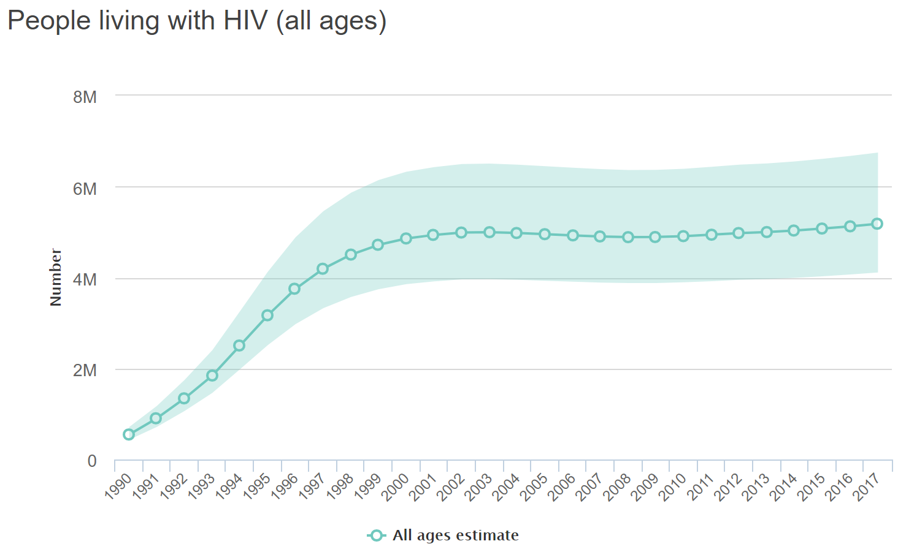
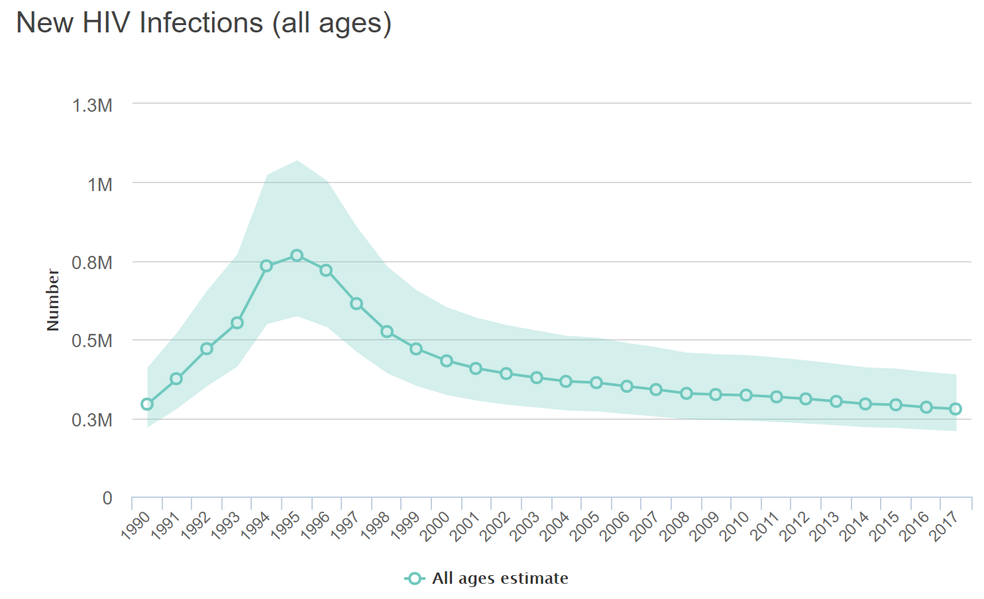
Epidemics in Asia are diverse and evolving
5.2 million living with HIV with 280,000 new infections
Source: aidsinfo.unaids.org based on UNAIDS 2018 estimates

Slide 3
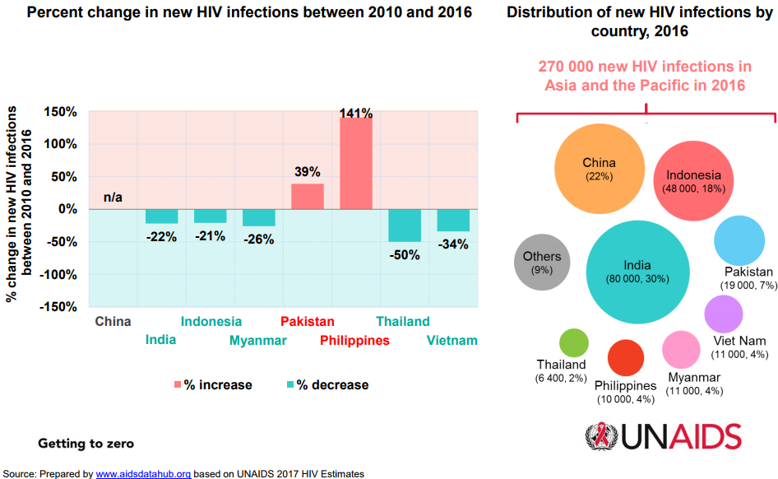
…but new infections are not distributed uniformly and not declining everywhere
Source: AIDS Data Hub from UNAIDS 2017 Estimates

Slide 4
In 2006, Commission told us to focus on key populations….but have things changed?
How important is prioritizing key populations today?
What can we achieve with adequate resources?
What’s the most effective way to prevent HIV among non-key populations?
How can we use models to target responses more effectively?
How can we make models more useful for guiding programs?

Slide 5
Explored impacts of changing responses to epidemics in Asia
Based on 11 countries using AIDS Epidemic Model (AEM) for national projections in 2017
AEM can explore
impact of changing programs
  Contains key populations
  critical in Asian epidemics
  Simulates HIV transmission
    Vaginal, anal and needle sharing
FSW/ISW
MSM/MSW
Client
PWID(M/F)
Low or no risk
male
TG
Low or no risk
female
Countries: Bangladesh, Indonesia, Cambodia, Lao PDR, Myanmar, Malaysia, Nepal, the Philippines, Pakistan, Thailand and Viet Nam

Slide 6
Built 5 scenarios:
Baseline: KP program coverage stays as today, ART scales as country currently plans
Fast Scale-up: KP coverage to 90% in 2020, ART in all populations to 81% in 2020, 90% in 2030
KP ART Scale-up: KP program coverage stays as today, ART for KPs scaled to 81% in 2020, 90% in 2030, ART for other populations as currently planned
Partner Prevention: 30% reduction of spousal transmission by 2020 and 50% by 2025
Scale-back: Assume coverage of KP programs scales back, while ART is sustained at current levels

Slide 7
What does the current situation look like?

Slide 8
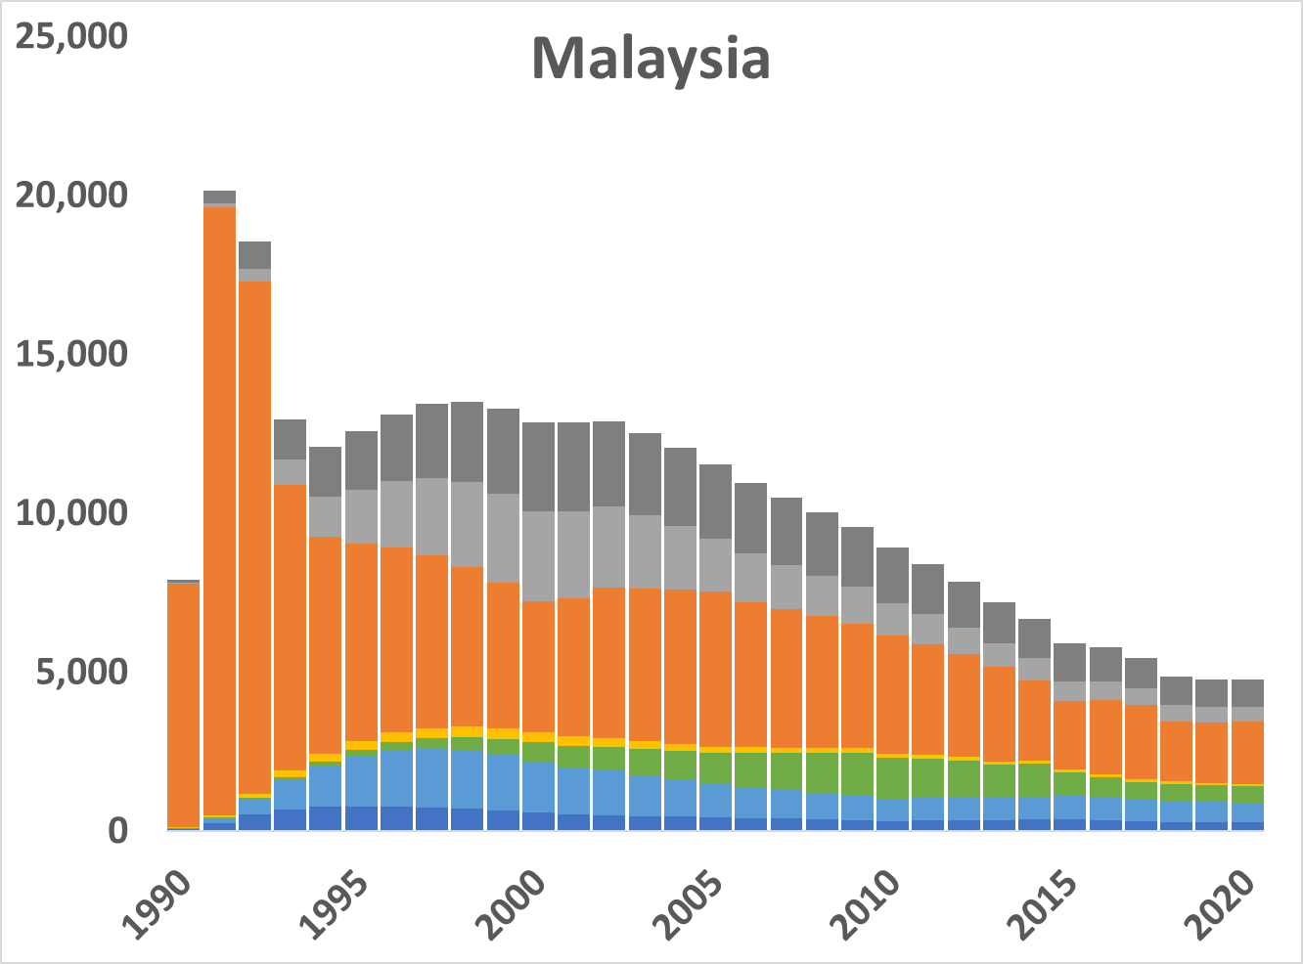
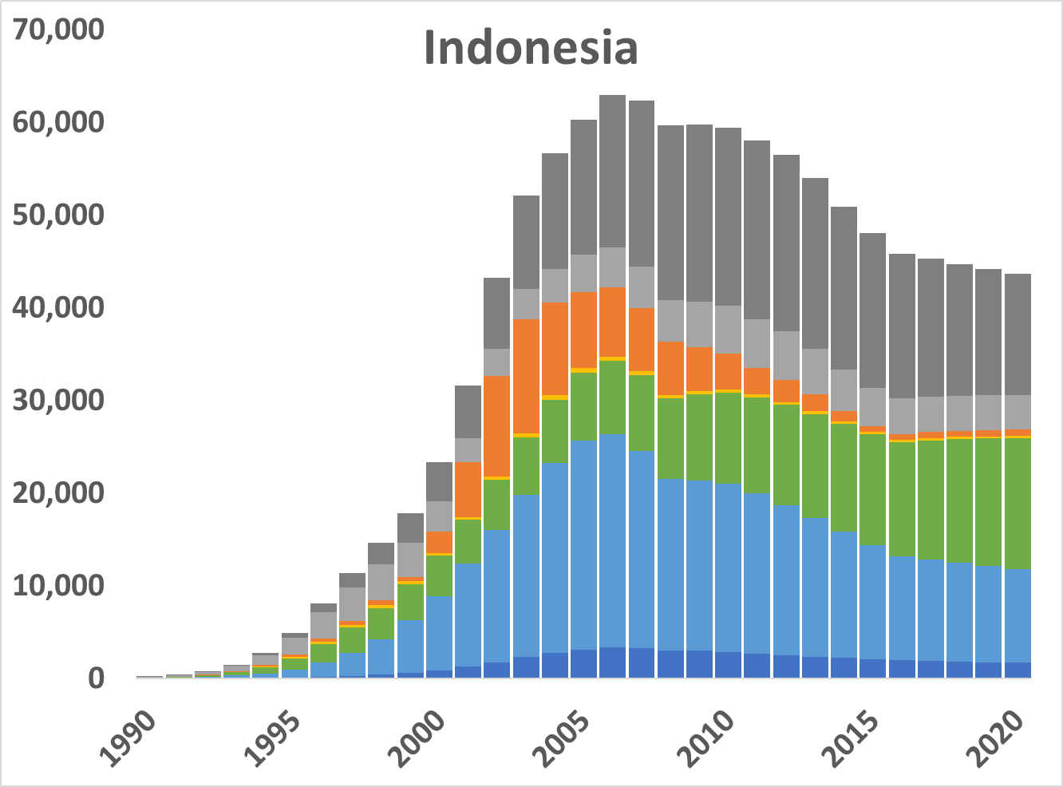
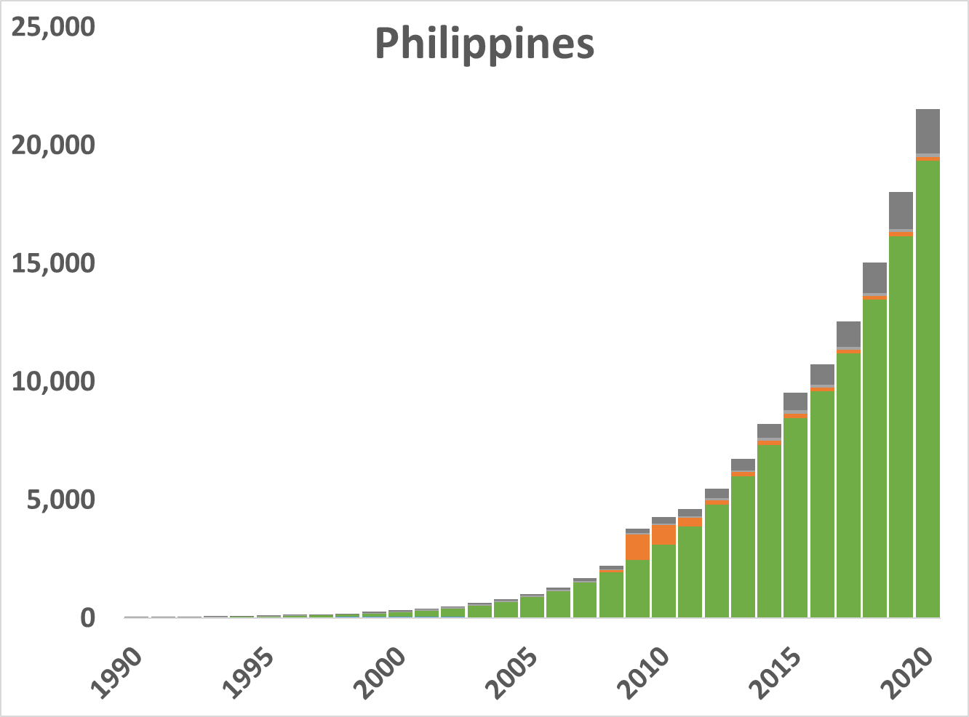
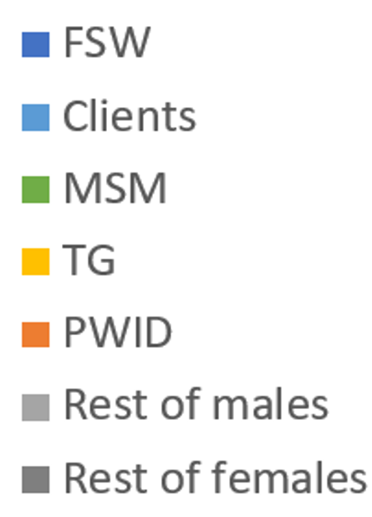
Countries vary substantially across Asia
In both pattern & intensity of new infections

Slide 9
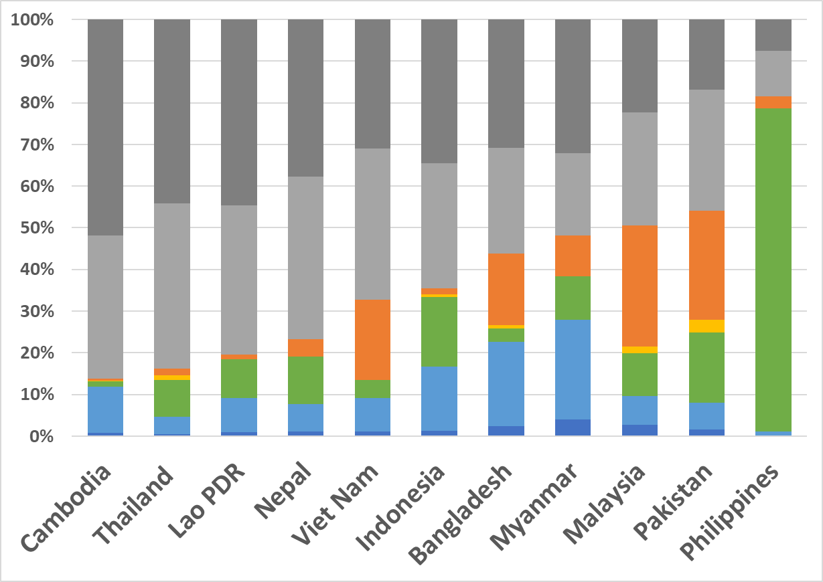
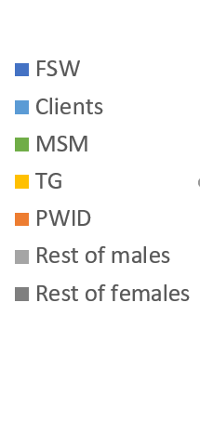
Current infections show wide epidemic variation between countries in 2017
Older epidemics have more infections among non-key populations

Slide 10
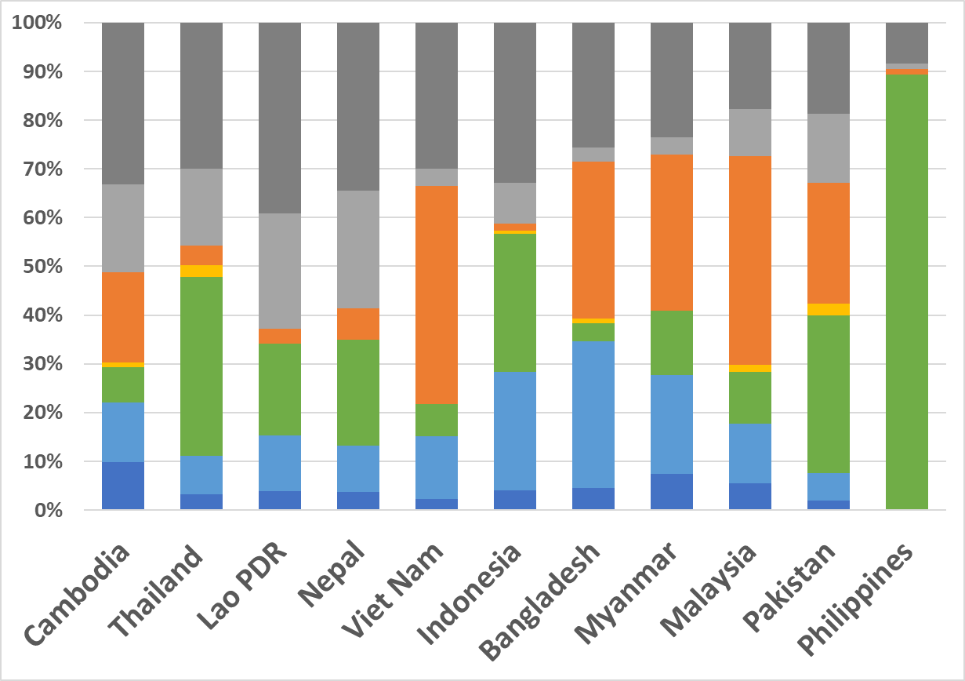
..but new infections show even more diversity among the countries
This gives a picture of what is driving transmission today

Slide 11
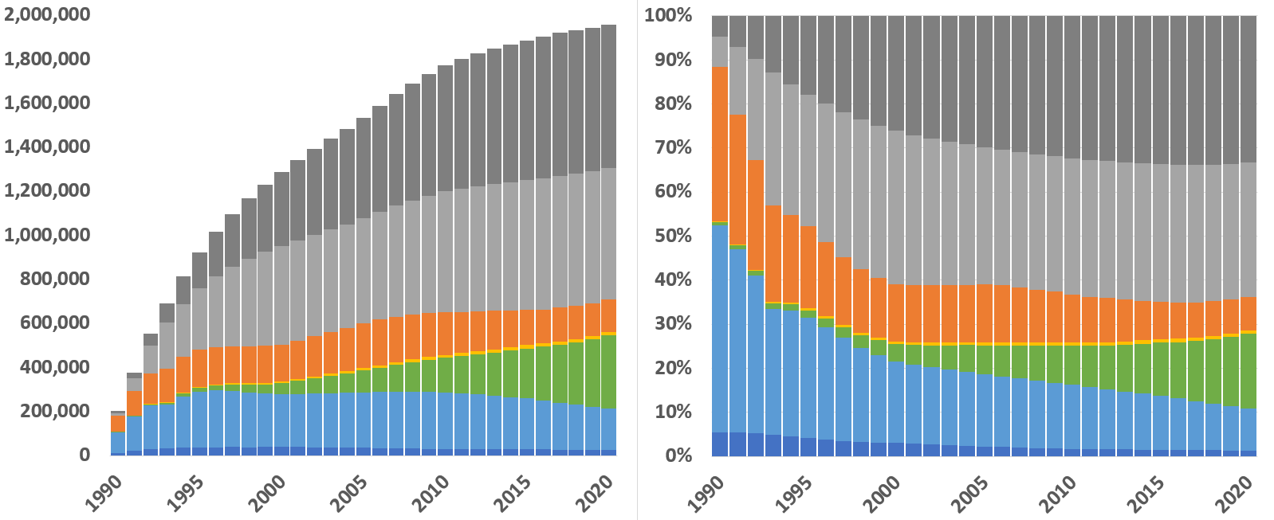
Current infections: two-thirds in non-KPs
By 2018, 65% of current infections are outside of key populations

Slide 12
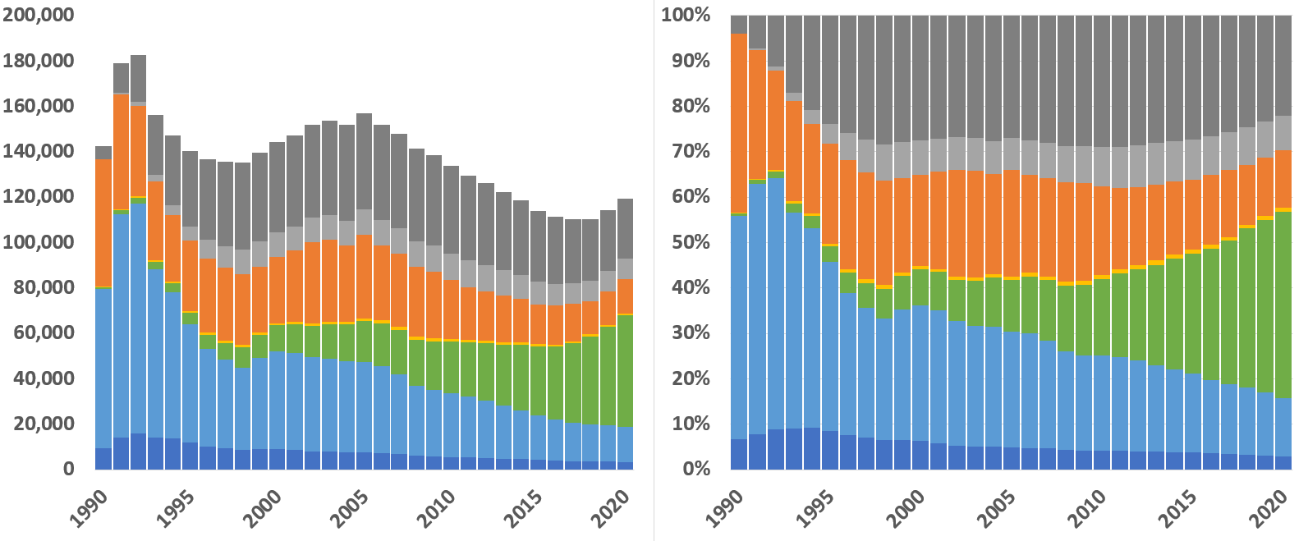
New infections: two-thirds in key populations
Only 33% of new infections in 2018 are outside of key populations
Also, the number of new infections in non-KP women is 3x that of men

Slide 13
What do baselines tell of Asian dynamics?
Contribution of different key populations varies widely between countries
  Calls for different emphases in the national response
Sex work and PWID components slowly and steadily declining
MSM component of epidemic is growing
  Regional decline in new infections may soon reverse
Older, more severe epidemics have more current and new infections among non-KPs

Slide 14
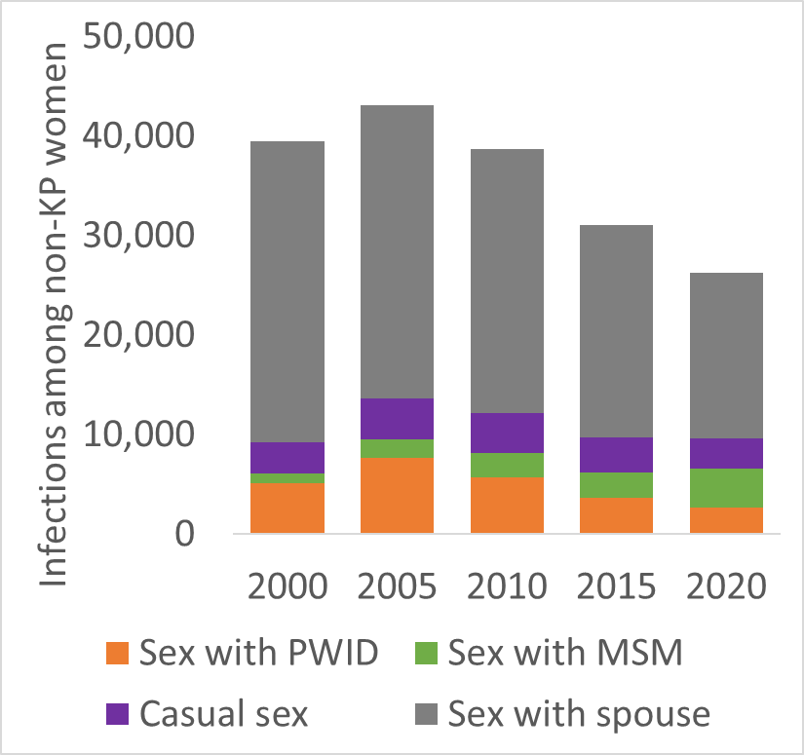
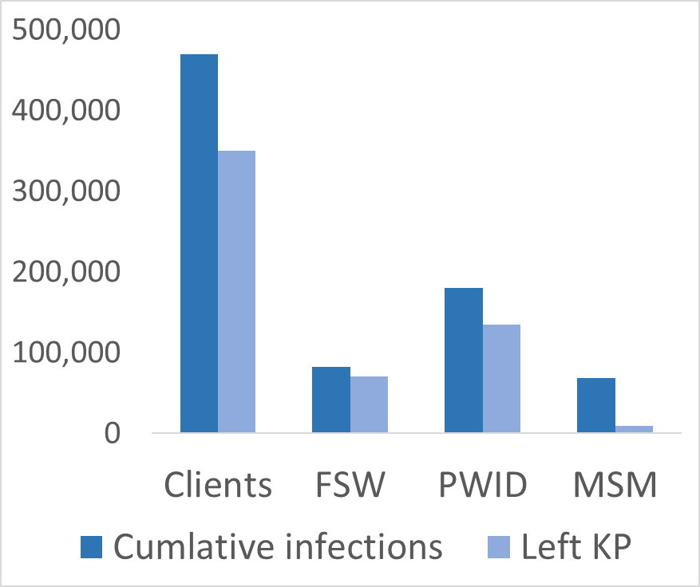
Does growth in infections among non-KPs mean the epidemic has “gone generalized”?
No, three factors contribute bulk of these infections:
  Members of key populations have intimate partners
  Key populations not closed, turnover moves ex-KPs back into “general” population
  Former members of key populations living with HIV eventually transmit to spouses
AEM does include “casual sex”
  Only produces 2.5% of all infections over the course of epidemic
Thailand
turnover
thru 2017

Slide 15
These patterns of new infections have critical program implications
Each country must tune its response to focus resources where its new infections occur
The MSM component is growing
  Prevention remains weak & is challenging
Programs for intimate partners of current and former key population members needed
  Insufficient emphasis in current KP-focused programs

Slide 16
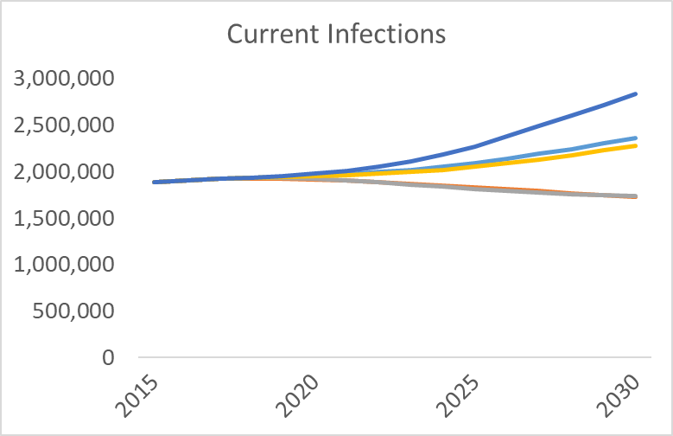
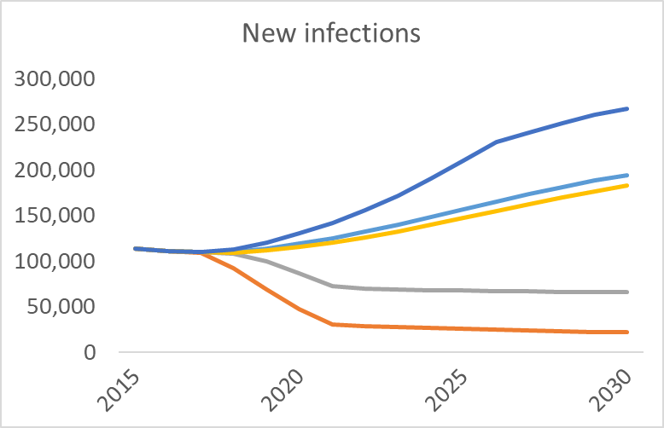
What do the scenarios show?
Notes:
Redo these from 2010 only with larger single caption across both

Slide 17
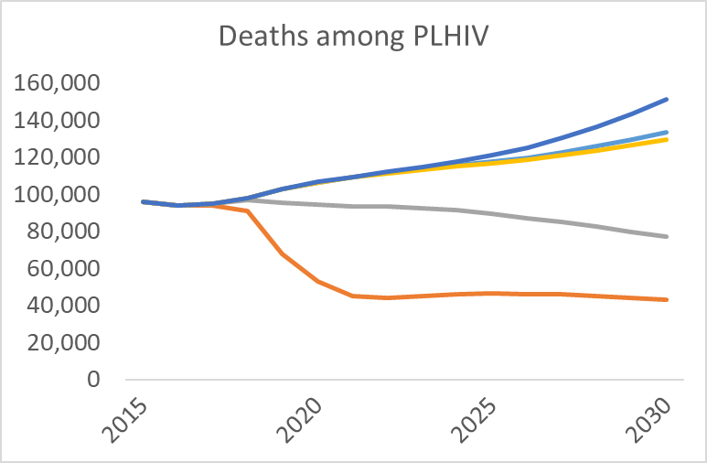
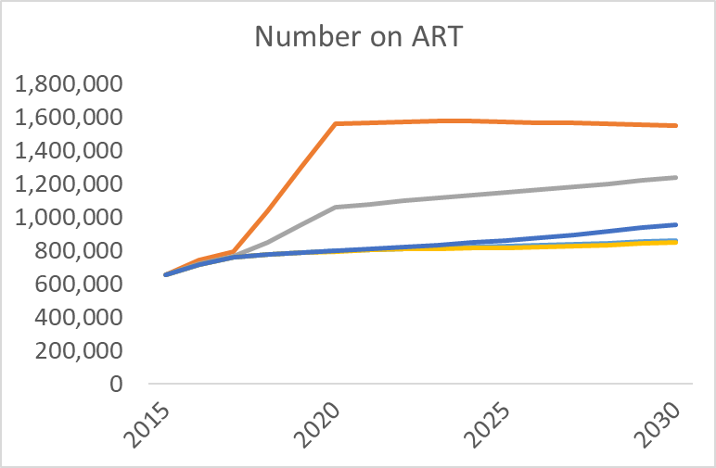
What do the scenarios show?
Notes:
Redo these from 2010 only with larger single caption across both

Slide 18
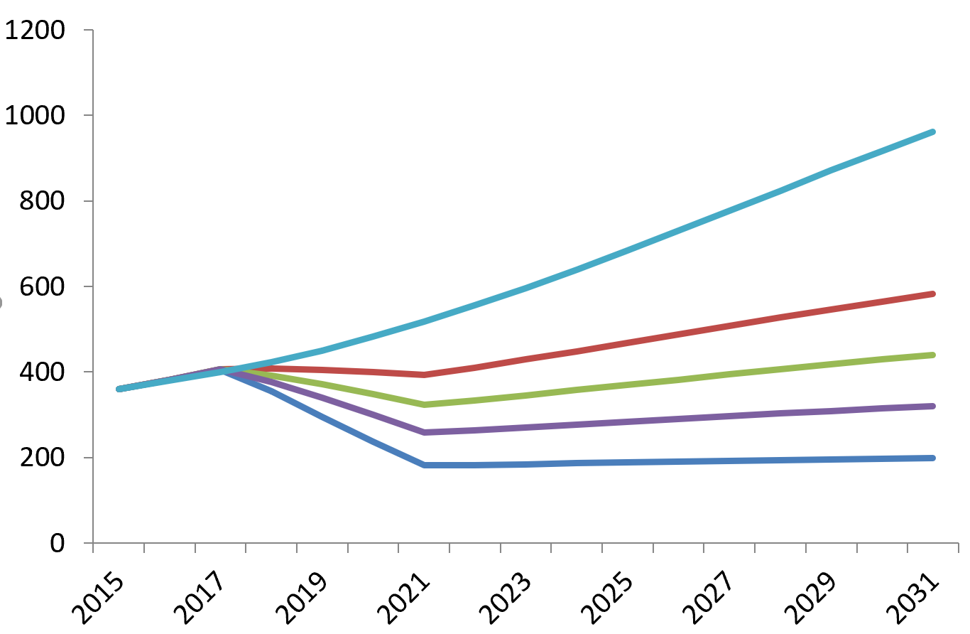
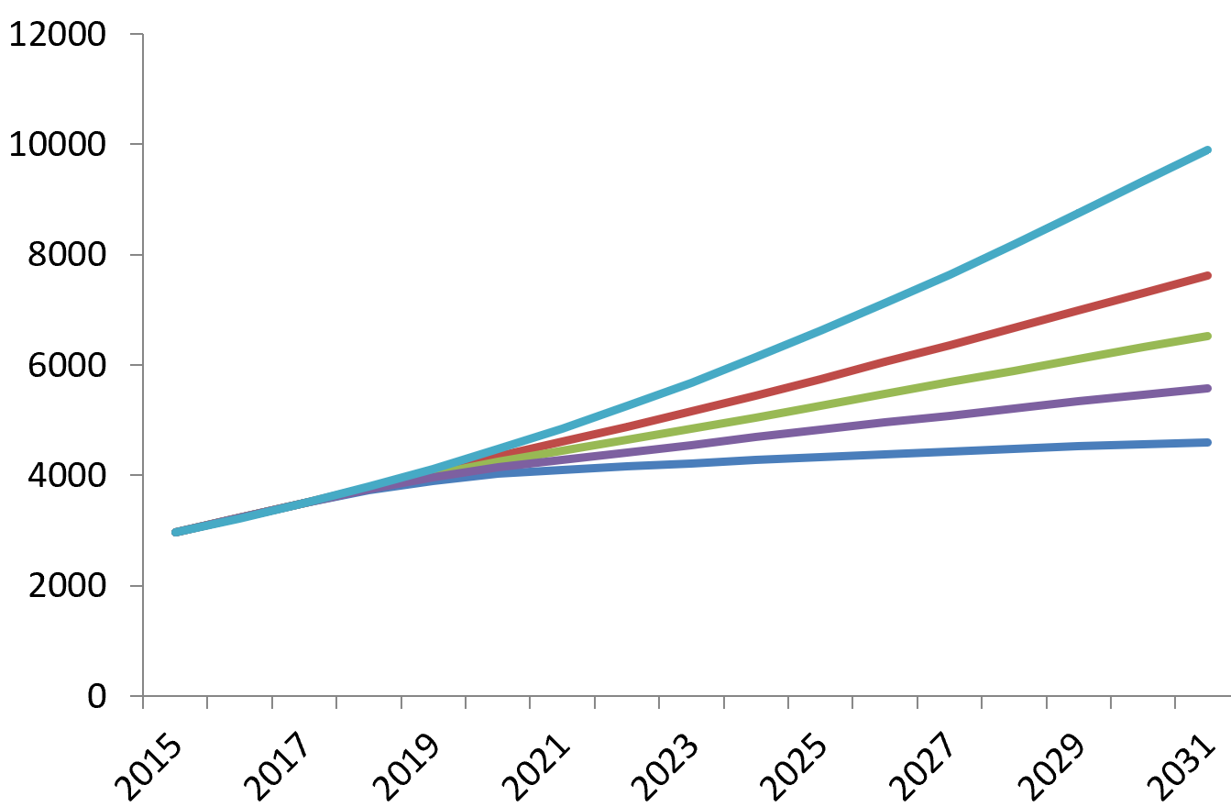
Prevention challenges: MSM
Incidence Hong Kong MSM
MSM contribution growing rapidly
High condom use & ART coverage needed to reverse epidemic
  Anal sex is high efficiency
Community norms & support are critical to support
  Testing
  Condom use
  Adherence
  Adoption of PrEP
Baseline
ART 81 C 65
ART 81 C 70
ART 81 C 75
ART 90 C 80
Prevalence Hong Kong MSM
Decline in prevalence will take
decades if ART coverage high
Source: Presentation to
Advisory Council on AIDS
Hong Kong June 2016

Slide 19
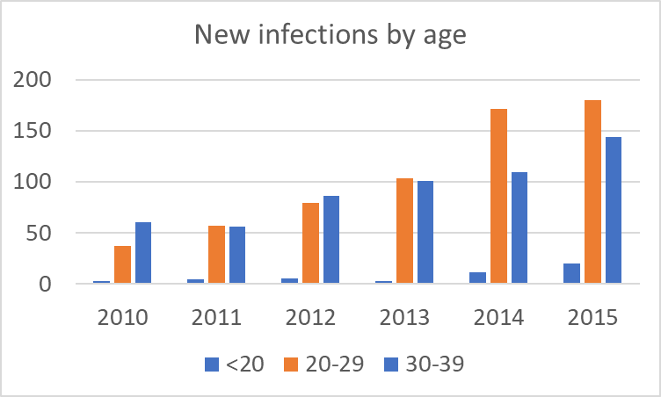
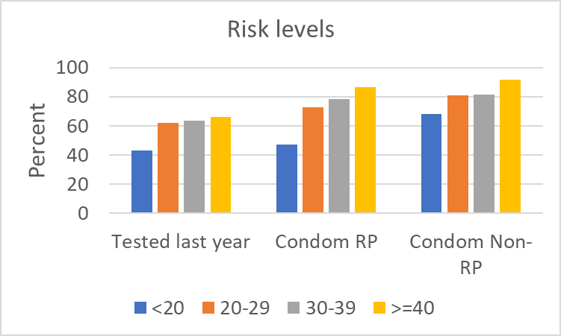
Prevention challenges: targeting right segments within key populations for impact
Young MSM an example
  Higher infection levels
  Lower testing
  Lower condom use
  Less likely on ART
Each key population has higher risk segments
  Prioritize for targeting
Source: ACA, Recommended HIVAIDS
Strategies for Hong Kong (2017-2021)

Slide 20
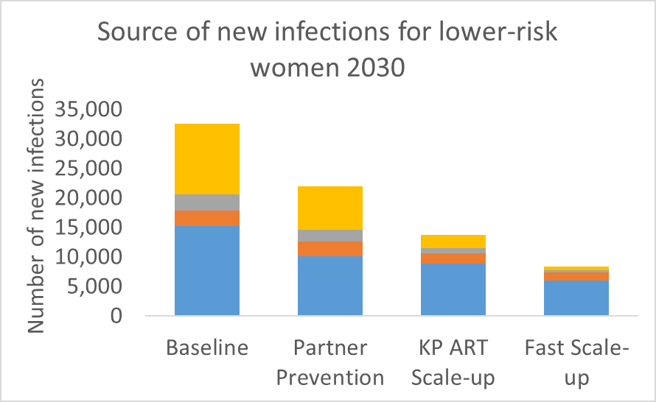
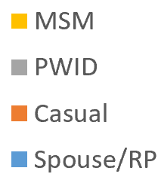
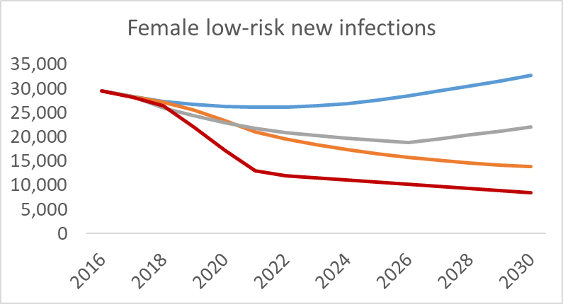

Prevention challenges: protecting lower risk women
Two main sources of transmission:
  Current KP partners
  Partners who were KP, including clients
Address most effectively by KP focused responses
  Includes positive prevention
Combination of KP + intimate partner programs would increase impact

Slide 21
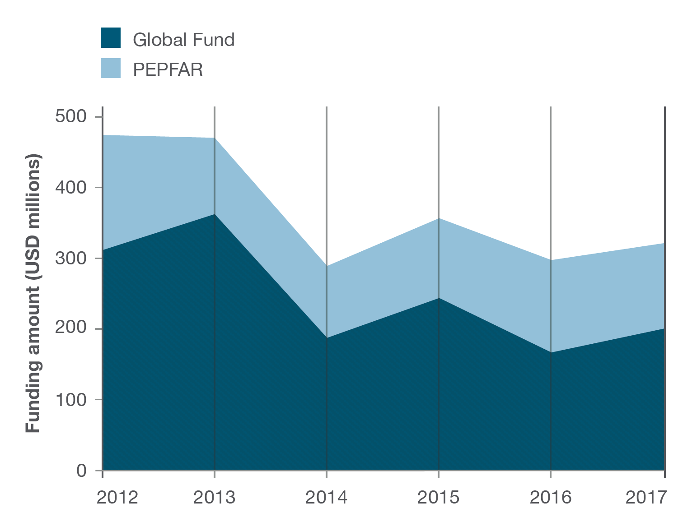
Financial challenges are a real concern for key population prevention efforts in Asia
Key population prevention still heavily dependent on external funding
International funding declining
  Globally funding is down
  Asian countries graduating
Domestic resources targeted primarily at ART
Means to maintain strong prevention in UHC era unclear
Source: amfAR, Funding gaps could put
Asia further behind on HIV/AIDS

Slide 22
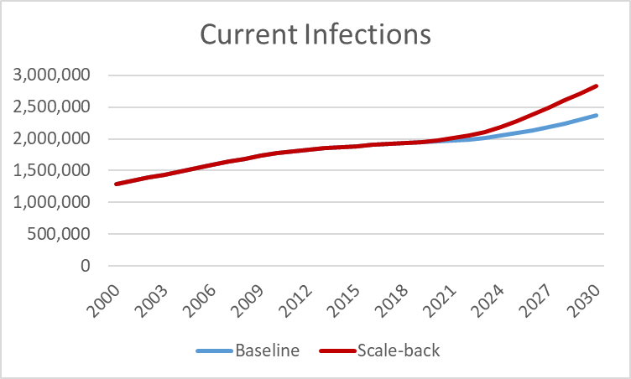
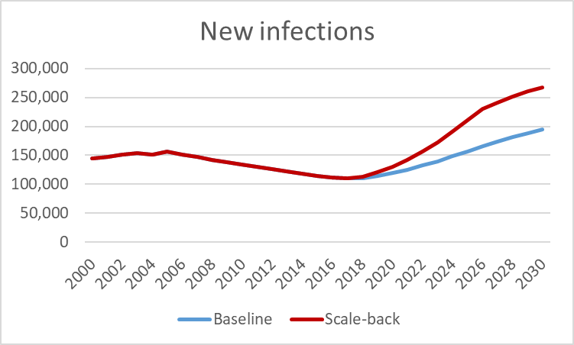
Impacts of scaling-back
471,000 more current infections in 2030
  20% increase
534,000 more new infections 2017-2030
  26% increase

Slide 23
How does Asia respond effectively to End AIDS?

Slide 24
Focus our resources for impact
Keep key populations at the core of Asian responses
Recognize KP programs are most effective way to protect lower risk women, including intimate partners
KP focused ART can greatly reduce transmission
  HIV testing strategies should focus on KPs for maximum yield
  Policies of treat all and immediate linkage to treatment essential
Special emphasis needed to find more effective programs for MSM and intimate partners of KP/ex-KP
Community engagement, program support and norms play a critical part in achieving what is shown

Slide 25
Use existing resources more efficiently
Growing resource constraints ► every $ counts
Models provide a valuable framework to:
  Collate & review diverse data, identify gaps
  Quantitate thinking on impact of programs, and
  Cooperatively explore scenarios for varying responses
Several key ways to improve responses:
  Geoprioritization, improving allocative efficiency, better targeting within key populations, adapting models to better guide programs

Slide 26
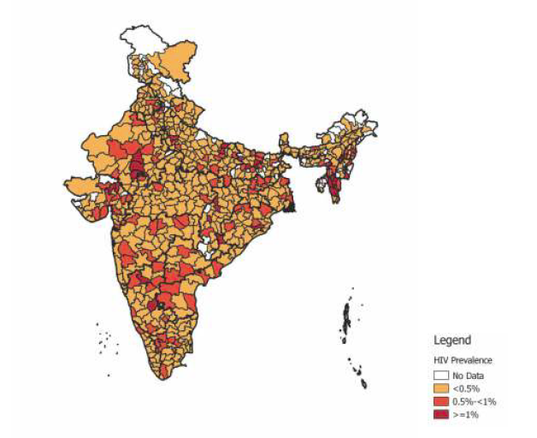
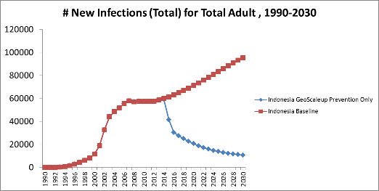
Geoprioritize & fight fires in the hot spots
HIV and risk are not distributed uniformly
  HIV clusters in hotspots
  KP numbers vary by place
Careful analysis of surveillance and case reporting, size estimates, and risk reports can identify hotspots
Models can assess impacts of focusing on them
Modeling increasing moving sub-national
Source: NACO, HIV Sentinel Surveillance:
Technical Brief, India 2016-17.

Slide 27
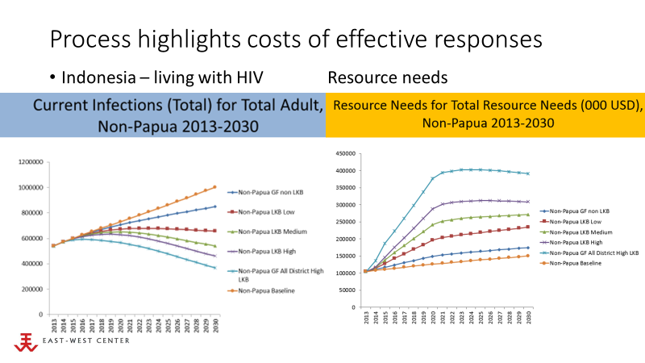
Improve allocative efficiency & mobilize resources domestically
Implement country processes engaging stakeholders to compare impacts and costs of alternatives

Slide 28
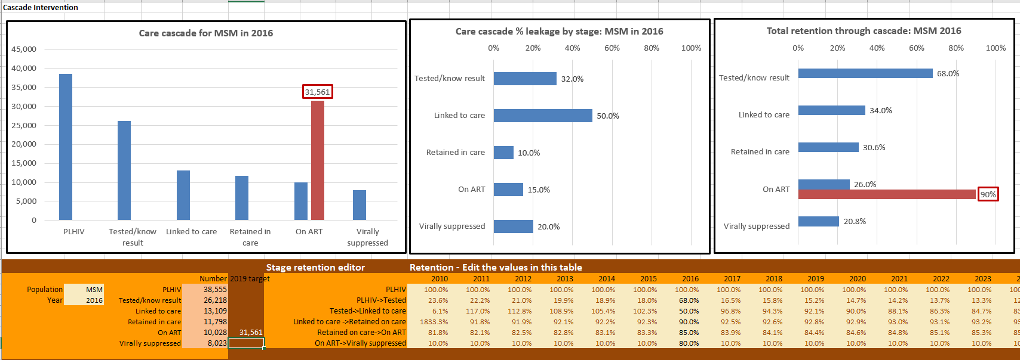
Adapt models to better guide programs
Work with cascade initiatives to provide feedback to strengthen programs
  Develop models as a framework for cascade data & discussion
  Work with local programs to ensure models meet their needs

Slide 29
We can end AIDS in Asia, but we must focus more intensely, mobilize additional domestic resources & use every $ to maximum effect.

Slide 30
Acknowledgements
The AEM country teams in:
  Bangladesh, Indonesia, Cambodia, Lao PDR, Myanmar, Malaysia, Nepal, the Philippines, Pakistan, Thailand and Viet Nam
Those supporting AEM development & application:
  WHO SEARO
  Global Fund
  Gates Foundation through Avenir Health
  UNAIDS
  USAID, FHI and World Bank
The AEM Development team:
  Wiwat Peerapatanapokin, Robert Puckett, Nalyn Siripong & Tim Brown

